Slide 1

ADJACENCY MATRICES
BUM 2223
DISCRETE STRUCTURE & APPLICATIONS

Slide 2
GROUP MEMBER
Nur Nabila Binti Rosli CA13016
Nur Syuhaidah Binti Ismail CB13006
Nor Amirah Binti Zahari CA13014
Natasha Shafira Binti Atan CA13011

Slide 3
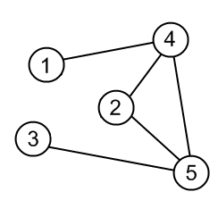
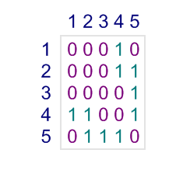
INTRODUCTION
Adjacency matrices represent which vertices of graph are adjacent to which vertices.
Each cell a_{ij} of an adjacency matrix contains 0, if there is an edge between i-th and j-th vertices, and 1 otherwise.

Slide 4
PROBLEM STATEMENT
In developing adjacency matrices there is a few problem that occurs which is user are not aware with the use of matrices, way to implement matrices in our daily life and how it plays an important role. Basically, matrices allow logical manipulation of very large sets of numbers at once. More rigorously, matrices allow the solution of linear equation system in real world problems. Without the use of matrices it will be hard for the user to develop and designing their project. Since using matrices theory it will help reduce the workload, and make work much easier.

Slide 5
PROJECT BACKGROUND
This project title is creating an adjacency matrix of a graph by using programming language C++. Application of matrices are found in most scientific fields, in computer graphics matrices are used for project in 3-dimensional image into 2-dimensional screen. In probability matrices are used in algorithm that ranks the page in Google Search.

Slide 6
RESEARCH METHODOLOGY
Step 1 : Project Planning
Step 2 : Analyze Case Study
Step 3 : Survey Development
Step 4 : Data Collection & Analysis
Step 5 : Program Development
Step 6 : Reporting

Slide 7


